Slide 1
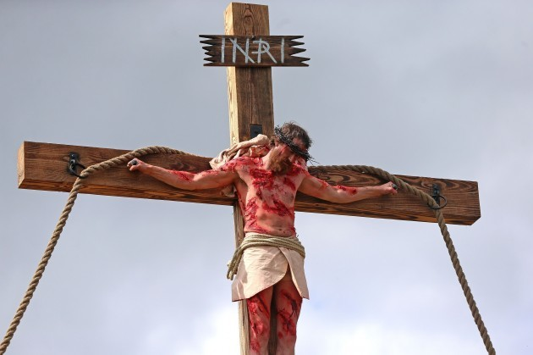
THE BLOOD OF JESUS –
THE ULTIMATE SACRIFICE

Slide 2
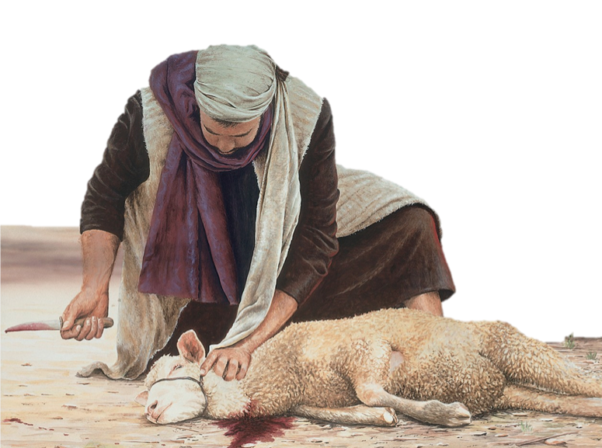
The Passover lamb

Slide 3
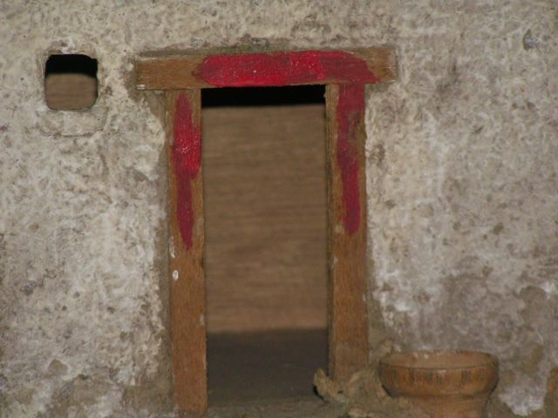
Blood on the doorposts

Slide 4
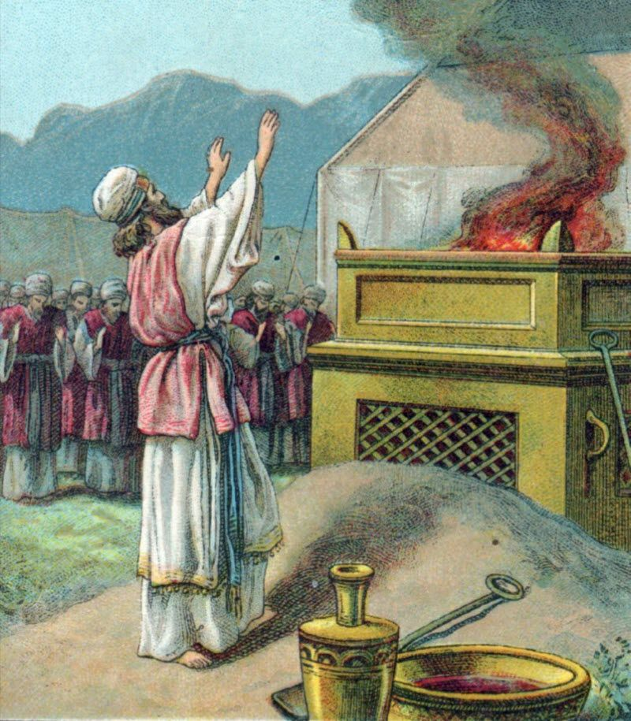
Regular sacrifices for sin

Slide 5
The Lamb of God who takes away the sins of the world

Slide 6
Symbols of blood in the Bible
Blood (particularly the blood sacrifice) symbolizes God’s covenant with his people
2. The blood symbolizes life
3. The blood symbolizes forgiveness and cleansing
4. The blood symbolizes access to God
5. The blood symbolizes victory in life

Slide 7
Symbols of blood in the Bible
Blood (particularly the blood sacrifice) symbolizes God’s covenant with his people.
The blood symbolizes life.
The blood symbolizes forgiveness and cleansing
The blood symbolizes access to God
The blood symbolizes victory in life.

